Slide 1
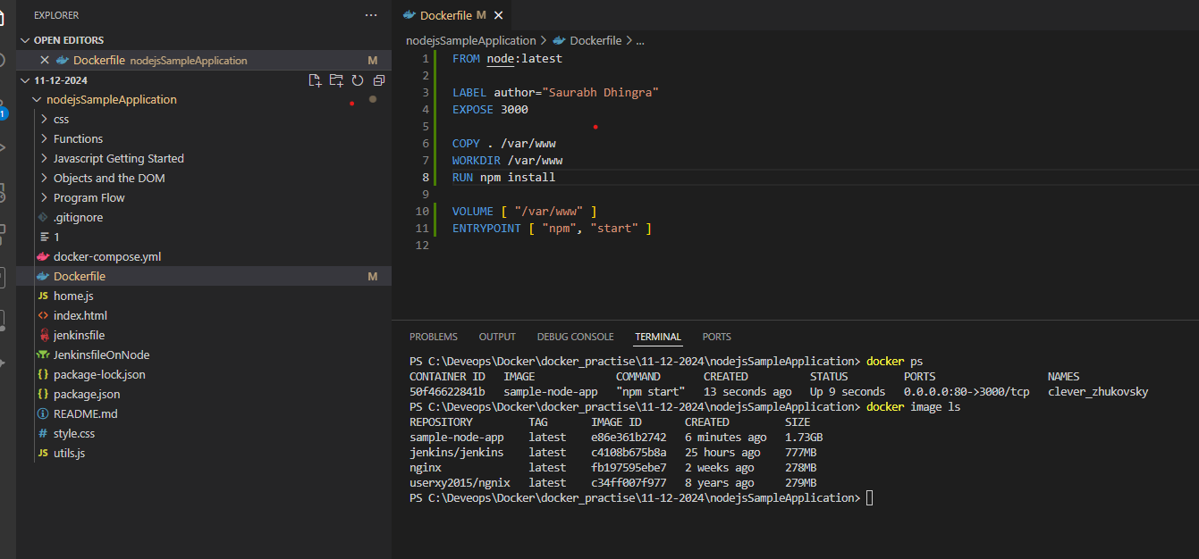
To Build and Deploy Nodejs APP
Git clone ---> Docker File ---> docker image --->Docker container

Slide 2
Commands used
Execute the below command to create an image -docker build -t sample-node-app .
docker image ls - Verify the image is created.
Create a container from the image. - docker run -d -p 80:3000 sample-node-app

Slide 3
